Slide 1



WEB TECHNOLOGIES
MINI PROJECT
BOOKNGO – AN ALL-IN-ONE ONLINE TRAVEL BOOKING WEBSITE
Done by
Aswinkumar I,
Sethupathy R

Slide 2
Existing System
Manual Booking: Most travel bookings are done manually or through fragmented platforms (hotel, transport, tours on separate sites).
Limited Integration: Users must visit multiple websites or apps to book hotels, transport, and tours.
No Centralized User Management
Minimal Automation
1. Share Auto Stops Integration
2. Local Bus Stops Mapping
3. Vehicle Rental Service
4. Unified Booking Experience
5. Enhanced Urban Mobility
Proposed System

Slide 3
Project Overview
BoooknGo is a full-stack travel booking platform.
Users can book hotels, tours, and transport.
Modern UI with AngularJS and Bootstrap.
Backend powered by Node.js, Express, and MongoDB.
User authentication (Login/Signup)
Hotel booking with filters (date, city, price)
Tour booking with package selection
Transport booking (local, intra-city, rental, flights)
Responsive design and smooth animations
Features

Slide 4
Technology Stack
Frontend: AngularJS, Bootstrap, HTML, CSS
Backend: Node.js, Express.js
Database: MongoDB Atlas
Testing: Selenium WebDriver (automated UI tests)
User Flow
User registers or logs in.
Navigates to booking pages.
Applies filters and selects options.
Books hotel, tour, or transport.
Confirmation and feedback.

Slide 5
Hotel Booking Module
Filter hotels by date, city, and max price.
View hotel details and images.
Book hotel (opens booking form in new tab).
Transport Booking Module
Tabs for Local, Intra-City, Rental, Flights.
Filter by date, source, destination, mode.
Local: Bus and Share Auto (no train).
Book button opens booking form.

Slide 6
Tour Booking Module
Select tour packages.
Choose room and transport options.
Book tour with user details.
Backend & API
RESTful API endpoints for bookings, users, transport.
Data stored in MongoDB Atlas.
Secure password handling with bcryptjs.

Slide 7
Testing & Validation
Selenium tests for booking forms.
Form validation for required fields and formats.
Error and success messages for user feedback.
Future Improvements
Add payment integration.
Enhance admin dashboard.
Improve mobile responsiveness.
Add more transport/tour options.

Slide 8
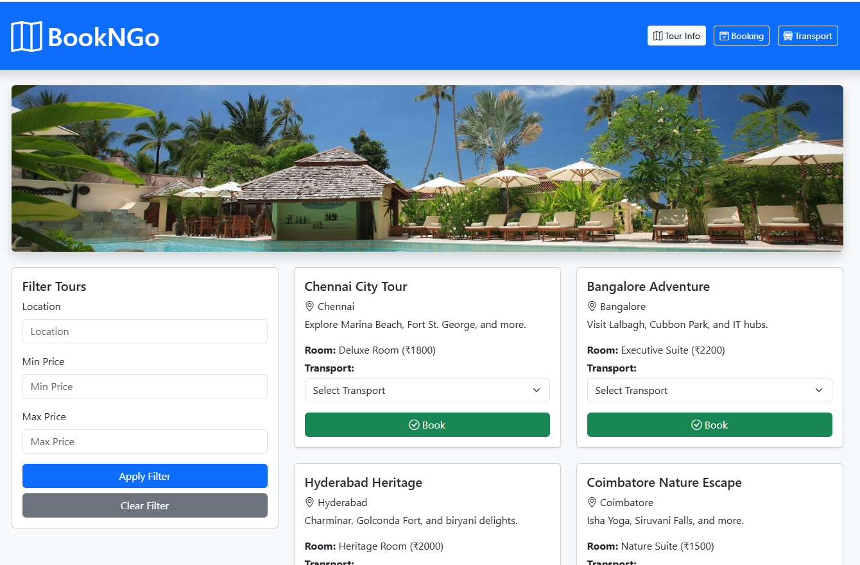
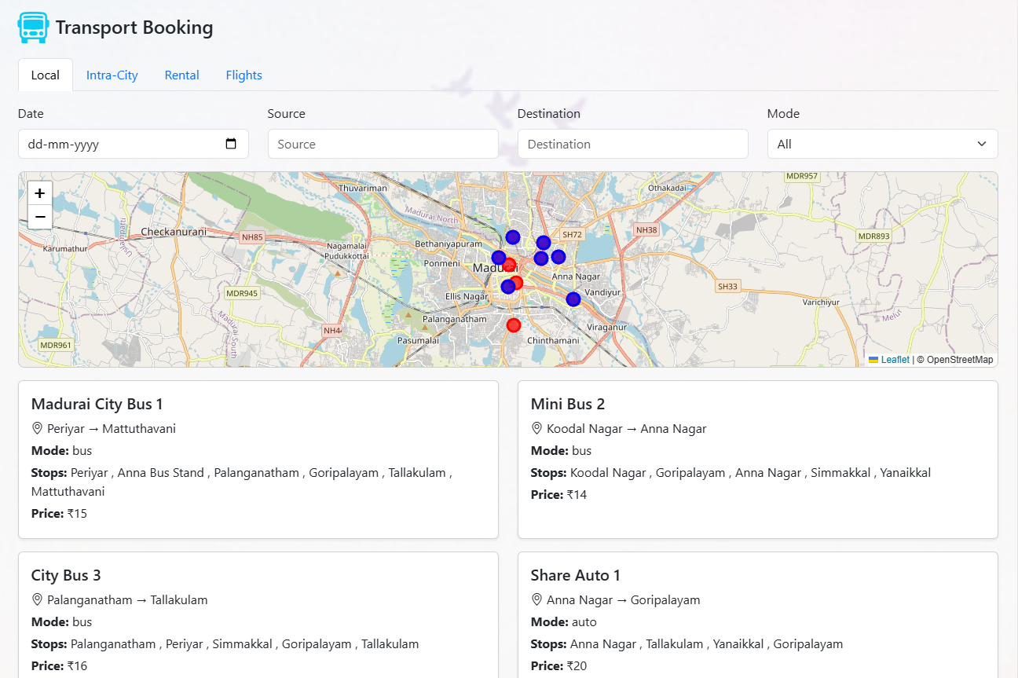
Demo & Screenshots

Slide 9
THANK YOU !

